Slide 1
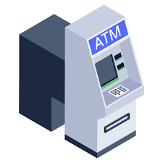
TriForce ATM Machine
Strength in Three, Banking with Ease!
Presented By :
Jahid Hasan . ID : 222-115-116
Team Member :
Abdullah Mohammed . ID : 222-115-116
Takbir Ali. ID : 222-115-109

Slide 2
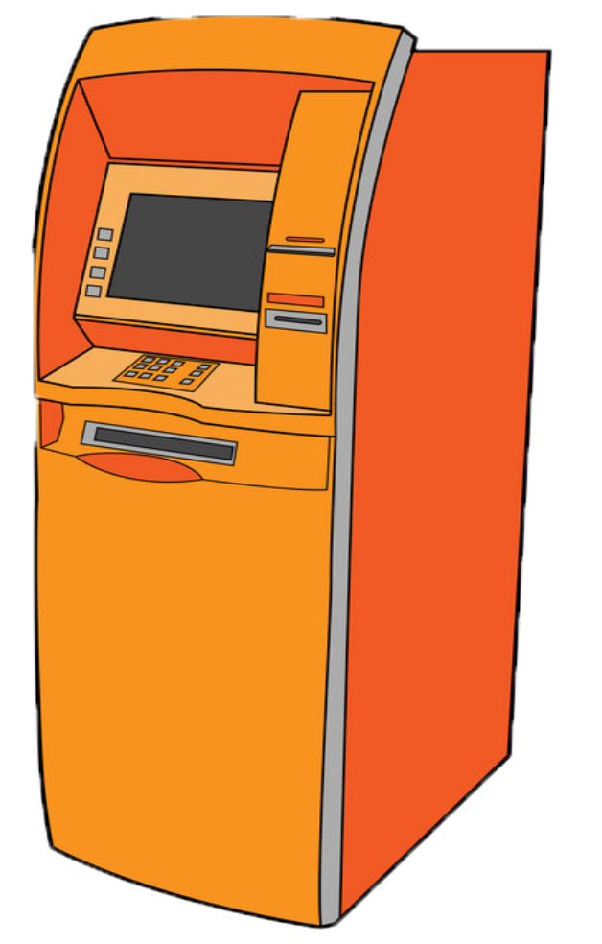
Introduction
The ATM (Automated Teller Machine) system is designed with user’s account and password , Bank account , with that user are able to withdraw deposit and view their account balance .

Slide 3
Code Structure
The code is organized into a package , reflecting a modular structure.
Account Class: Manages individual customer accounts, providing methods for account operations such as withdrawals, deposits, and balance inquiries.
OptionMenu Class: Handles user interactions by implementing login functionality and offering a menu system for selecting different account types and conducting transactions.
ATM Class: Serves as the main class to initiate the ATM system, creating an instance of the OptionMenu class.

Slide 4
User Interaction
User Authentication with getLogin Method
Enhancing Robustness with Exception Handling
The getLogin method in the OptionMenu class is responsible for authenticating users. It prompts users to enter their customer number and PIN, handling potential exceptions related to invalid input.
Exception handling ensures that only numerical input is accepted during the login process, enhancing the robustness of the authentication mechanism.

Slide 5
Account Operations
Managing Account Information and Transactions
Efficient and Secure User Credential Validation
The Account class manages account information and transactions. It includes methods for calculating withdrawals, deposits, and retrieving account balances.
Customer numbers and corresponding PINs are stored in a HashMap, providing an efficient and secure way to validate user credentials.

Slide 6
Menu System
Orchestrating User Interactions
Account Type Selection and Operations
The OptionMenu class orchestrates user interactions by presenting a menu system. It guides users through account type selection (checking or saving) and specific account operations (view balance, withdraw, deposit, or exit).
The flow of the program seamlessly transitions from login to account type selection, maintaining an intuitive user experience.

Slide 7
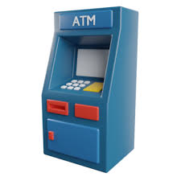
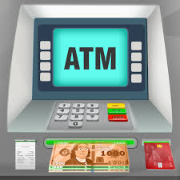

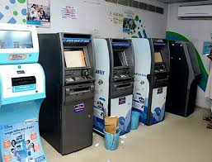
Conclusion
In summary, the ATM system encompasses fundamental banking operations, fostering ease of use and security. Key features include a structured codebase, user-friendly interfaces, and robust authentication mechanisms.

Slide 8
Let’s Run
The
“ TriForce ATM Machine ”

Slide 9
Now, It’s time to questions and discussions.
Please feel free to ask any queries or share your thoughts.

Slide 10
Thank You!

